Slide 1
erwin Creating Outdoor Recreation Economies (CORE) 2025-2030
North Carolina Department of Commerce
Main Street & Rural Planning Center
Funding for this program made possible by the US Economic Development Administration
Notes:
Good evening, Mayor Baker, Commissioners…
I’m Bruce Naegelen, Community Economic Development Planner for the North Central Prosperity Zone – with the NC Main Street & Rural Planning Program, Rural Economic Development Division of NC Commerce.

Slide 2
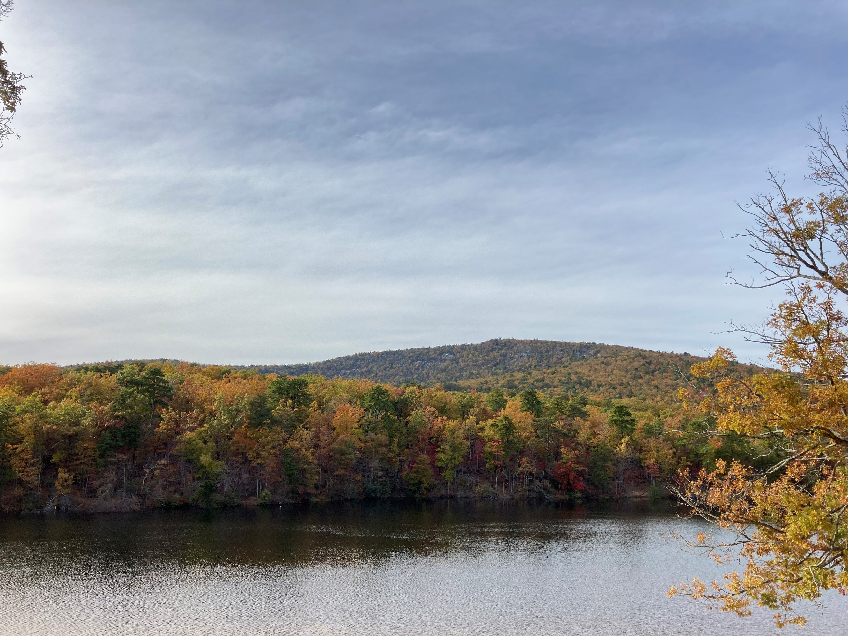
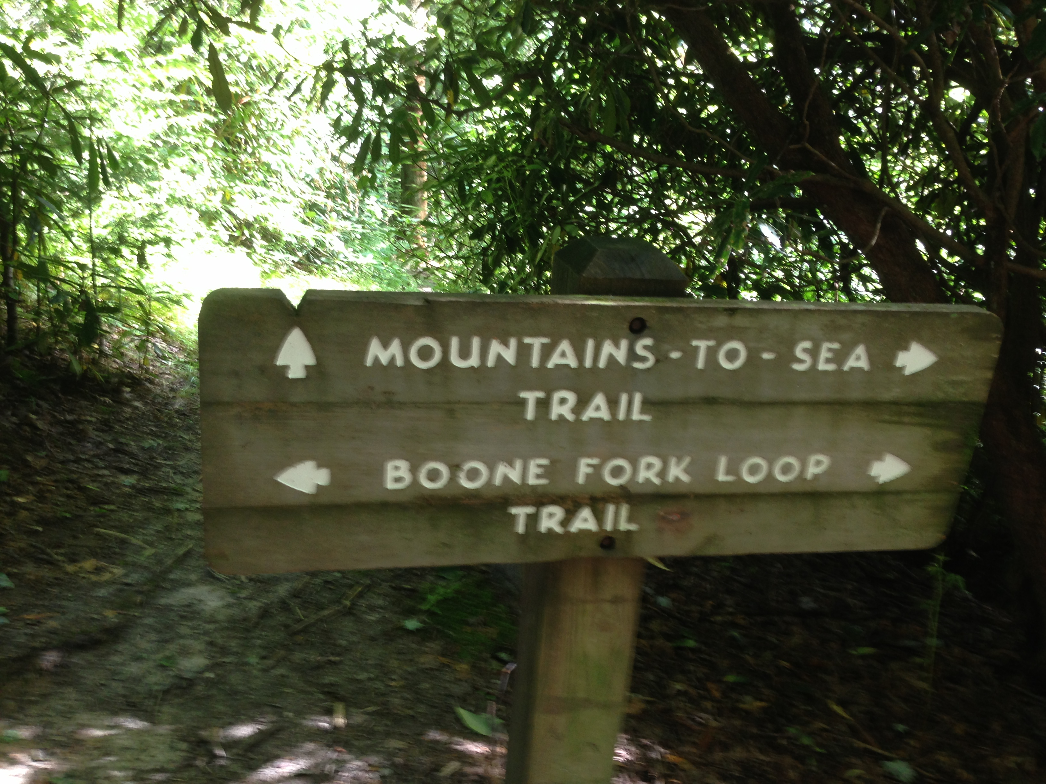
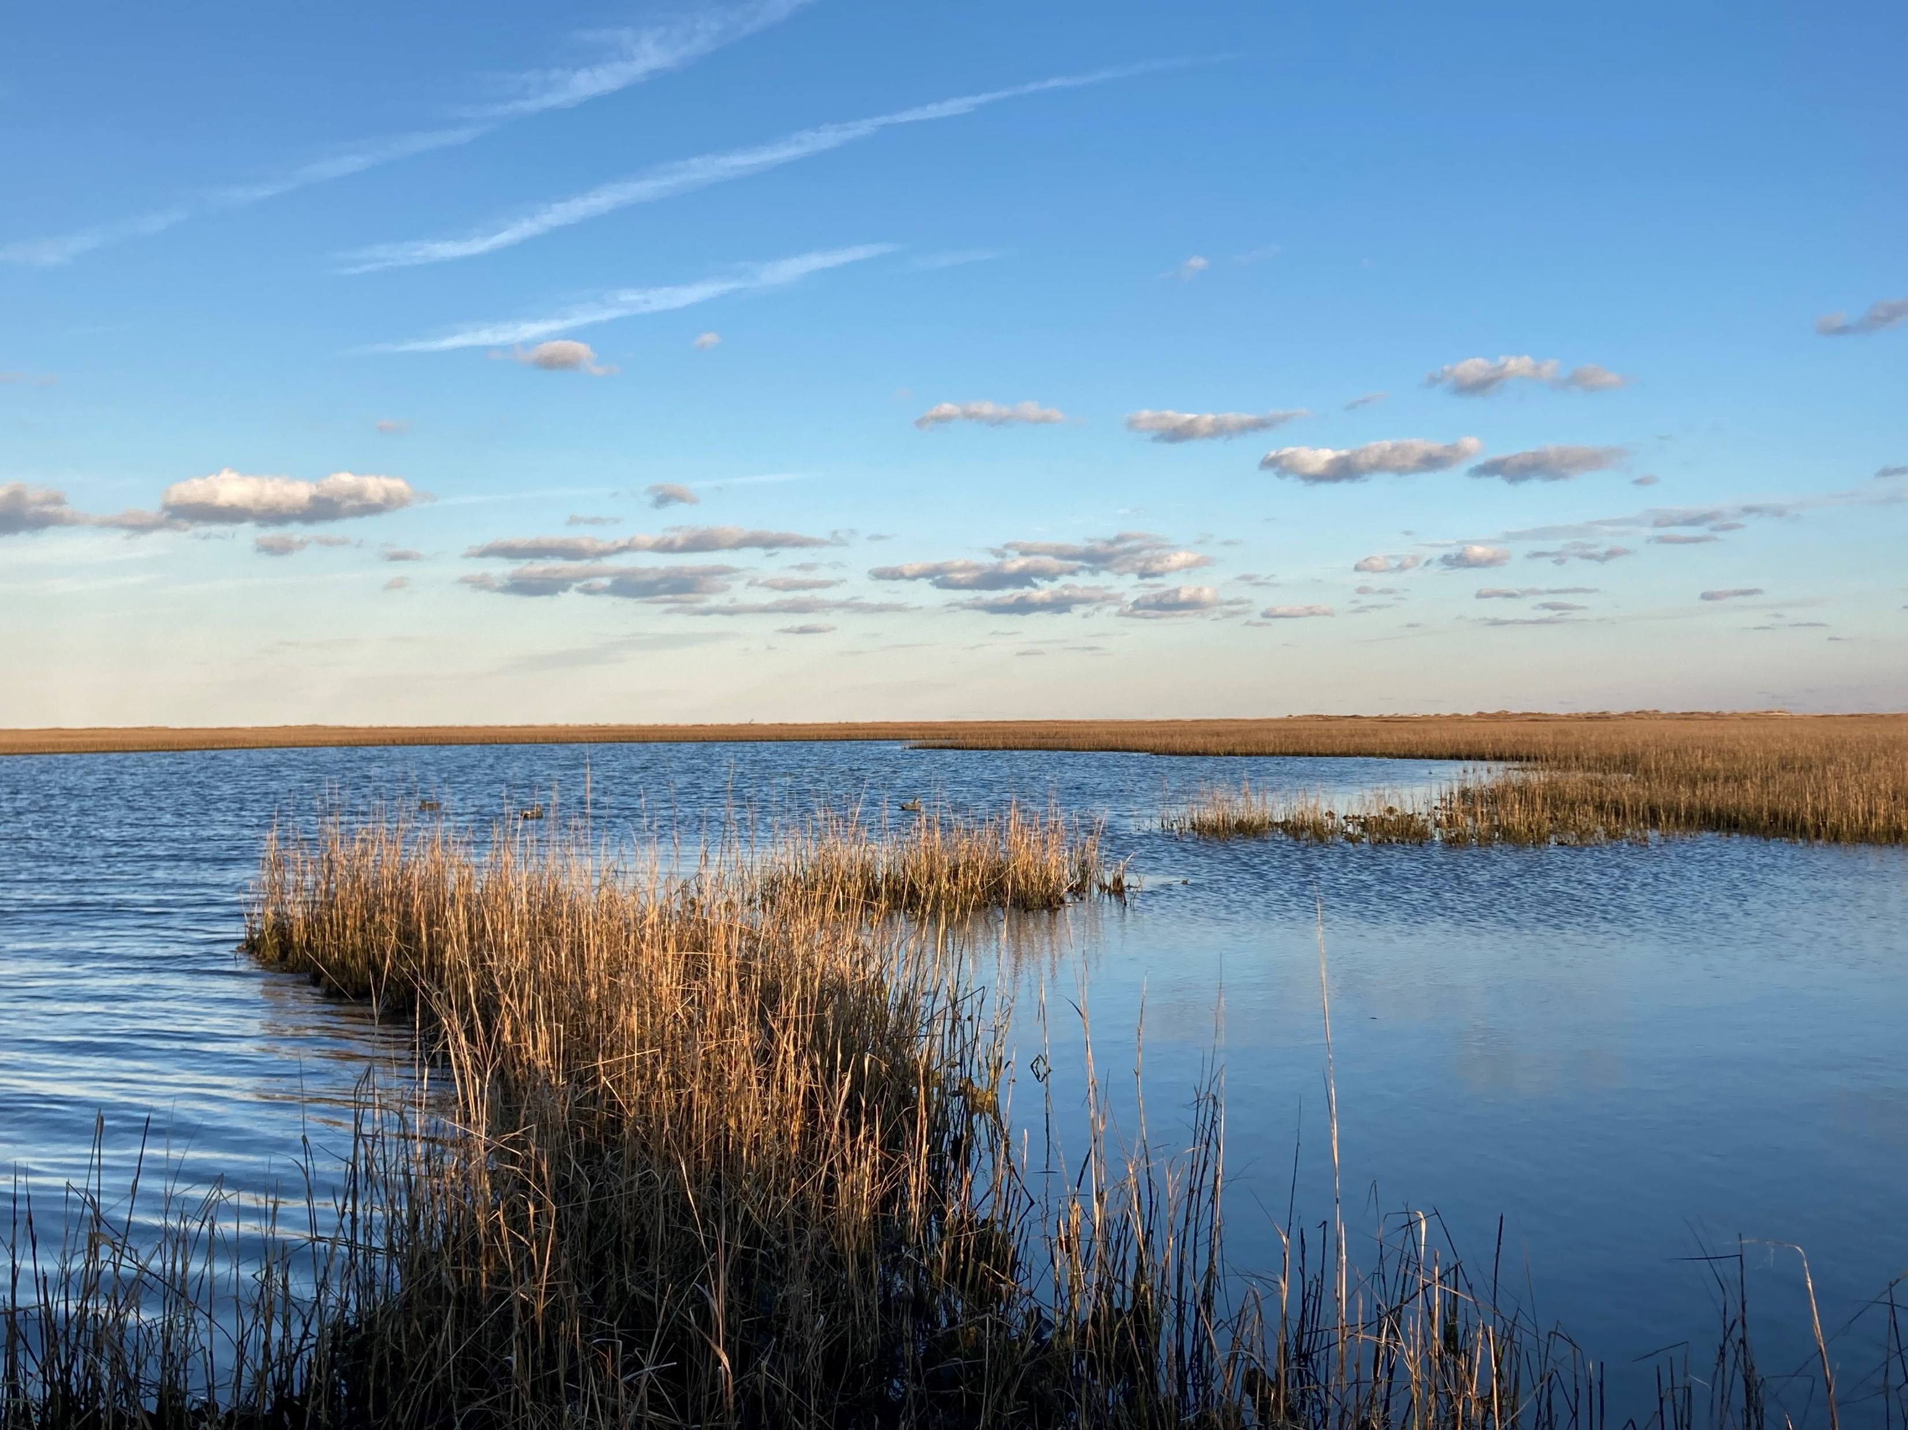
CREATING OUTDOOR RECREATION ECONOMIES
Technical Assistance for Outdoor Recreation Economy
Strategic Planning & Asset Development
Our goal is to help rural communities leverage natural assets to increase economic opportunity through the outdoor recreation economic sector.
Notes:
In the fall of 2022, the NC Department of Commerce’s Main Street & Rural Planning Center announced a technical assistance program called Creating Outdoor Recreation Economies (CORE).
It offers planning and asset development to leverage outdoor recreation resources available across the state of North Carolina to bolster local economic vitality.
In October 2022, Erwin applied to participate in the new program and formalized that participation with a Memorandum of Understanding which you adopted in September 2023.
This strategic plan has an implementation horizon of five years – and the Rural Economic Division of NC Commerce will provide on-going assistance.

Slide 3
Definition of Outdoor Recreation
All recreational activities undertaken for leisure that occur outdoors, with an emphasis on those activities that involve some level of intentional physical exertion and occur in nature-based environments.
Team sports, ball fields, and playground equipment is generally not the focus of this planning effort.
Notes:
This is a definition of Outdoor Recreation – “recreational activities undertaken for leisure that occur outdoors, that involves some level of intentional physical exertion and occurs in nature-based environments.

Slide 4
Outdoor Recreation Economies - Defined
The outdoor recreation economy is the web of service and product-based businesses associated with outdoor recreation activities.
Stakeholders include:
Outfitters & Guide Services
Gear Designers & Manufacturers
Product Retailers & Gear Service Shops
Hospitality & Food Service
Travel-oriented Businesses
Notes:
The outdoor recreation economy is the web of service and product-based businesses associated with outdoor recreation activities.
Stakeholders include:
Outfitters & Guide Services
Gear Designers & Manufacturers
Product Retailers & Gear Service Shops
Hospitality & Food Service
Travel-oriented Businesses

Slide 5
North Carolina’s Outdoor Recreation Economy
$16.1 billion in total Outdoor Recreation Value Added economic impact (BEA ORSA 2023)
145,000 direct jobs statewide across the Outdoor Recreation Satellite Account categories (BEA ORSA 2023)
Resulting in $7.7 billion in wages and compensation for North Carolina workers

Slide 6
Planning Process
Town of Erwin, NC
Notes:
The program focuses on activities communities can do to:
Increase tourism
Encourage small business development
Position communities to attract outdoor gear manufacturing industries
Plan for outdoor recreation asset and infrastructure development
Enhance quality of life improvements for residents

Slide 7
Work Group Meetings
13 individuals representing county and town staff, business owners, economic development/tourism professionals, and outdoor enthusiasts
7 sessions from October 2023 - November 2024
Shared input and reviewed community input data to develop vision and workplan
Upon review of the final draft, they voted to recommend to the Board of Commissioners to adopt.
Notes:
The CORE Work Group met 7 times between October 2023 and November 2024, at which time the members reviewed the implementation plan and made a recommendation to the board of commissioner adopt.
(if asked… there were gaps equaling 7 months for various reasons: holidays, budget, and preparation)

Slide 8
Work Group Meetings
The CORE Work Group members are: Randy Baker, Mayor, Town of Erwin
Snow Bowden, Town Manager, Erwin
Carl Davis, Director, Harnett County Recreation
Dylan Eure, Planner, Town of Erwin
Lauren Evans, Town Clerk, Town of Erwin
Justin Hembree, Executive Director, Mid-Carolina Regional Council
Wesley Johnson, Erwin Mill Representative/ Tourism Board Member
Rashawn King, Program Manager, Triangle Trails Initiative
Jay Sikes, Assistant Director, Harnett County Development Services/Planning Svcs
Angie Stewart, Economic Developer, Harnett County
Frank Toth, President, Erwin Chamber of Commerce
Don Wilson, Athletic Director, Town of Erwin
Grace Watts, Erwin Planning Board
Samantha Wullenwaber, Deputy Executive Director, Mid-Carolina Regional Council
AnnMarie Yow, Mid-Carolina Regional Council
Notes:
The 15 members of the all-star CORE Work Group were very active, informative and dedicated through this entire process. Their names are listed on the screen, but if any of the members of the work group, are here tonight, please stand up….!

Slide 9
Additional Research
The technical team reviewed Erwin’s prior planning documents and community economic and demographic data
Created an outdoor economy asset map
NC Main Street staff developed a Retail Marketplace Snapshot for Erwin, which is located in the Appendix
Workgroup Survey which helped guide the process and is reflected in the report and Implementation Plan
Notes:
We reviewed the Town’s existing plans, including:
- Town of Erwin Land Use Plan
Erwin Community Economic Recovery & Resiliency Initiative (CERRI)
East Coast Greenway State Trail Plan
Harnett County Bicycle, Pedestrian & Greenway Plan
As well as regional and county plans, including:
2022-2027 Comprehensive Economic Development Strategy (CEDS)
2023 Brand & Image Position – Dunn & Harnett County Survey

Slide 10
ASSET MAPPING
Town of Erwin
Notes:
The Erwin Outdoor Recreation Asset Map highlights publicly-controlled properties and the federal, state, and local levels.

Slide 11
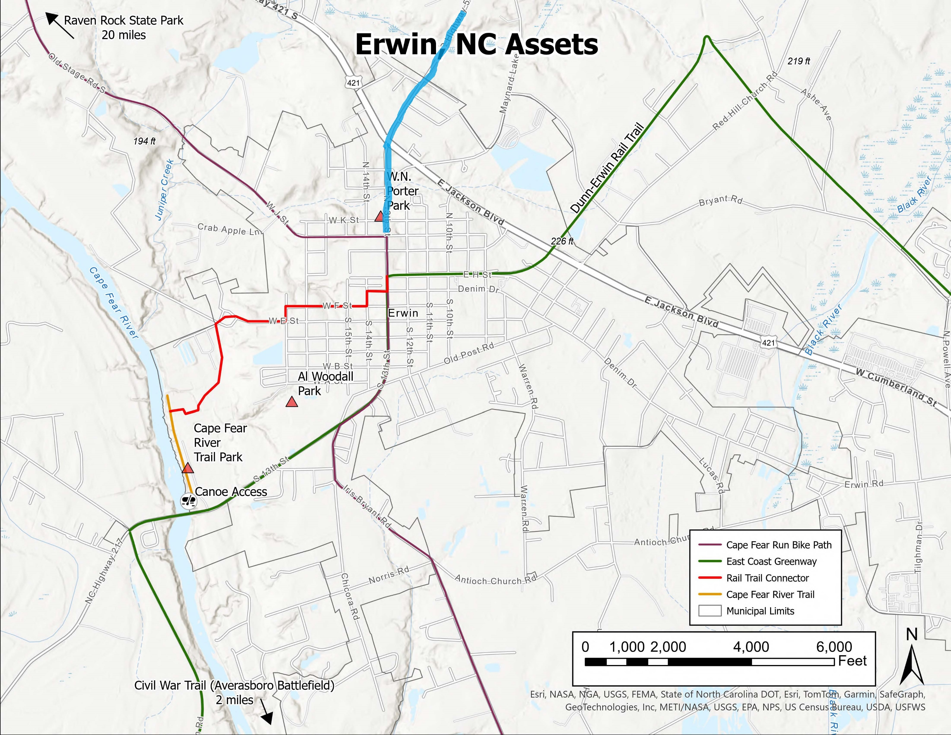
Notes:
Some of the major outdoor recreation assets in Nashville include:

Slide 12
OUTDOOR RECREATION ECONOMIC POSITIONING STATEMENT
Town of Erwin, NC
Notes:
The economic positioning statement describes where you want Erwin’s outdoor recreation economy to be in the next 5-10 years.

Slide 13
Economic Positioning Statement
Erwin is the destination for those seeking to get back to the simple life. Where they can enjoy recreating on the Cape Fear and Black Rivers, and where all trails converge leading to historic Downtown.
Notes:
This statement was developed by the work group:
The Implementation Plan, which we’ll review in a moment, will help achieve this vision
When we’re finished with this presentation, we will be asking you to consider adopting the Implementation Plan which includes this Economic Positioning Statement.
READ STATEMENT:
Erwin is the destination for those seeking to get back to the simple life. Where they can enjoy recreating on the Cape Fear and Black Rivers, and where all trails converge leading to historic Downtown.

Slide 14
CORE STRATEGIC PLAN (5-YEAR)
Town of Erwin
Notes:
And now we’ll review the Implementation Plan!

Slide 15
Notes:
There are 4 Strategies, 5 Goals, 21 Objectives and proposed actions and projects to achieve those objectives and goals..

Slide 16
STRATEGIES & GOALS
Strategy 1: Getting Back to the Simple Life Strategy 2: Accessing Trails for Health, Wealth, and Fun Strategy 3: Active Downtown Strategy 4: Activating the Cape Fear and Black Rivers
Notes:
To respect everyone’s time we will be presenting tonight a higher-level Implementation Plan with just Strategies, Goals and Objectives

Slide 17
Strategy 1: Getting Back to the Simple Life
Goal 1: Improve Quality of Life for Erwin Residents: Health & Wellness Objective 1.1: Maintain a (work) group that meets regularly and is dedicated to advancing the goals of this plan. Objective 1.2: Update existing Erwin Parks & Recreation Master Plan. and incorporate priorities/recommendations within the Erwin CORE plan. Objective 1.3: Improve resident engagement and participation in outdoor activities

Slide 18
Strategy 1: Getting Back to the Simple Life
Goal 1: Incorporate Outdoor Recreation with the Community Objective 1.4: Earmark annual funds to repair and improve walkability and accessibility of sidewalks and trails throughout Erwin Objective 1.5: Update & provide uniformity to existing/future wayfinding signage townwide including from US 421. (Land Use Plan/CERRI)

Slide 19
Strategy 2: Activating the Cape Fear & Black Rivers
Goal 2: Develop outdoor economic & recreational opportunities (safe, enjoyable use of rivers) Objective 2.1: Improve ramp and accessibility at Cape Fear River Trail Park Objective 2.2: Create at least 1 new public access to Cape Fear River by 2029 Objective 2.3: Support increased navigability of the Black River from Erwin toward Rhodes Pond

Slide 20
Strategy 2: Activating the Cape Fear & Black Rivers
Goal 2: Develop outdoor economic & recreational opportunities (safe, enjoyable use of rivers) Objective 2.4: Support and engage with partners to develop a regional Blueway along the Cape Fear River from Raven Rock State Park to Elizabethtown in Bladen County Objective 2.5: Connect Cape Fear River Trail downstream from Lillington to Erwin and to Fayetteville. (Harnett Bike, Ped, Greenway Plan -page 86) Objective 2.6: Extend use of Cape Fear River Bridge (page 87) Objective 2.7: Support Construction of Coats to Dunn-Erwin Rail Trail.

Slide 21
Strategy 3: Accessing Trails for Health, Wealth & Fun
Goal 3: Assure Access for All Populations to Trails & Amenities Objective 3.1: Increase participation and use of trails and outdoor recreation assets in Erwin by 5% annually Objective 3.2: Maintain and enhance the Dunn-Erwin Trail (Erwin LUP-TIS 2.2.2) Goal 4: Develop/Embrace Trail Safety-Outdoor Recreation Protocols and Practices Objective 4.1: Improve trail accessibility for First Responders Objective 4.2: Water & Trail Safety Education Programs

Slide 22
Strategy 3: Accessing Trails for Health, Wealth & Fun
Goal 4: Develop/Embrace Trail Safety-Outdoor Recreation Protocols and Practices Objective 4.3: Adopt “Trail Town” stewardship program objectives Objective 4.4: Consider becoming a designated “Trail Town” stewardship program

Slide 23
Strategy 4: Active Downtown
Goal 5: Position downtown Erwin as the center of cultural events and outdoor recreational activities Objective 5.1: Improve economic impacts of existing in-town and town-sponsored festivals, cultural & historical events, and tours by 5% annually. Objective 5.2: Encourage entrepreneurs to start businesses in Erwin Objective 5.3: Create a formalized public space downtown for events (LUP Goal 4)

Slide 24
CORE - UNC System Partners Strategic Plan Implementation Services
Town of Erwin
Notes:
One of the benefits of participation in the CORE program is the availability of implementation services provided by our UNC System Partners at NCGrowth – UNC Chapel Hill; Initiative for Community Growth and Development at NC State University; Crisp Small Business Resource Center, Miller School of Entrepreneurship, College of Business at east Carolina University and the Center for Industry research & Engagement, Bryan School of Business and Economics at UNC-Greensboro.

Slide 25
Notes:
Services include:
Feasibility studies,
Strategic plan Implementation
Market Analyses
Economic Impact Analysis
Design study services – such as for Downtown
Community Event Portfolios and Economic Impact Analyses
Destination management and marketing plans
Stakeholder management plans
Outdoor Recreation Consumer Profile Reports
And other options
We will work with the Town following adoption of the plan to determine one or two priority services

Slide 26
Next Steps
Adoption of the Creating Outdoor Recreation Economies (CORE) Strategic and Implementation Plan
Questions??
Notes:
I would like to reiterate this a 5-year plan, and my colleagues and I with the NC Main Street & Rural Planning Center, Rural Economic Development Division of Commerce will be following up and providing on-going assistance.
We are requesting that the board adopt the Erwin Creating Outdoor Recreation Economies Strategic and Implementation Plan.
I will be glad to answer any questions…

Slide 27
Bruce Naegelen
Community Economic Development Planner, North Central 984.365.0279 Bruce.Naegelen@commerce.nc.gov 8998 US 70 Hwy Business West Clayton, NC 27520

