Slide 1
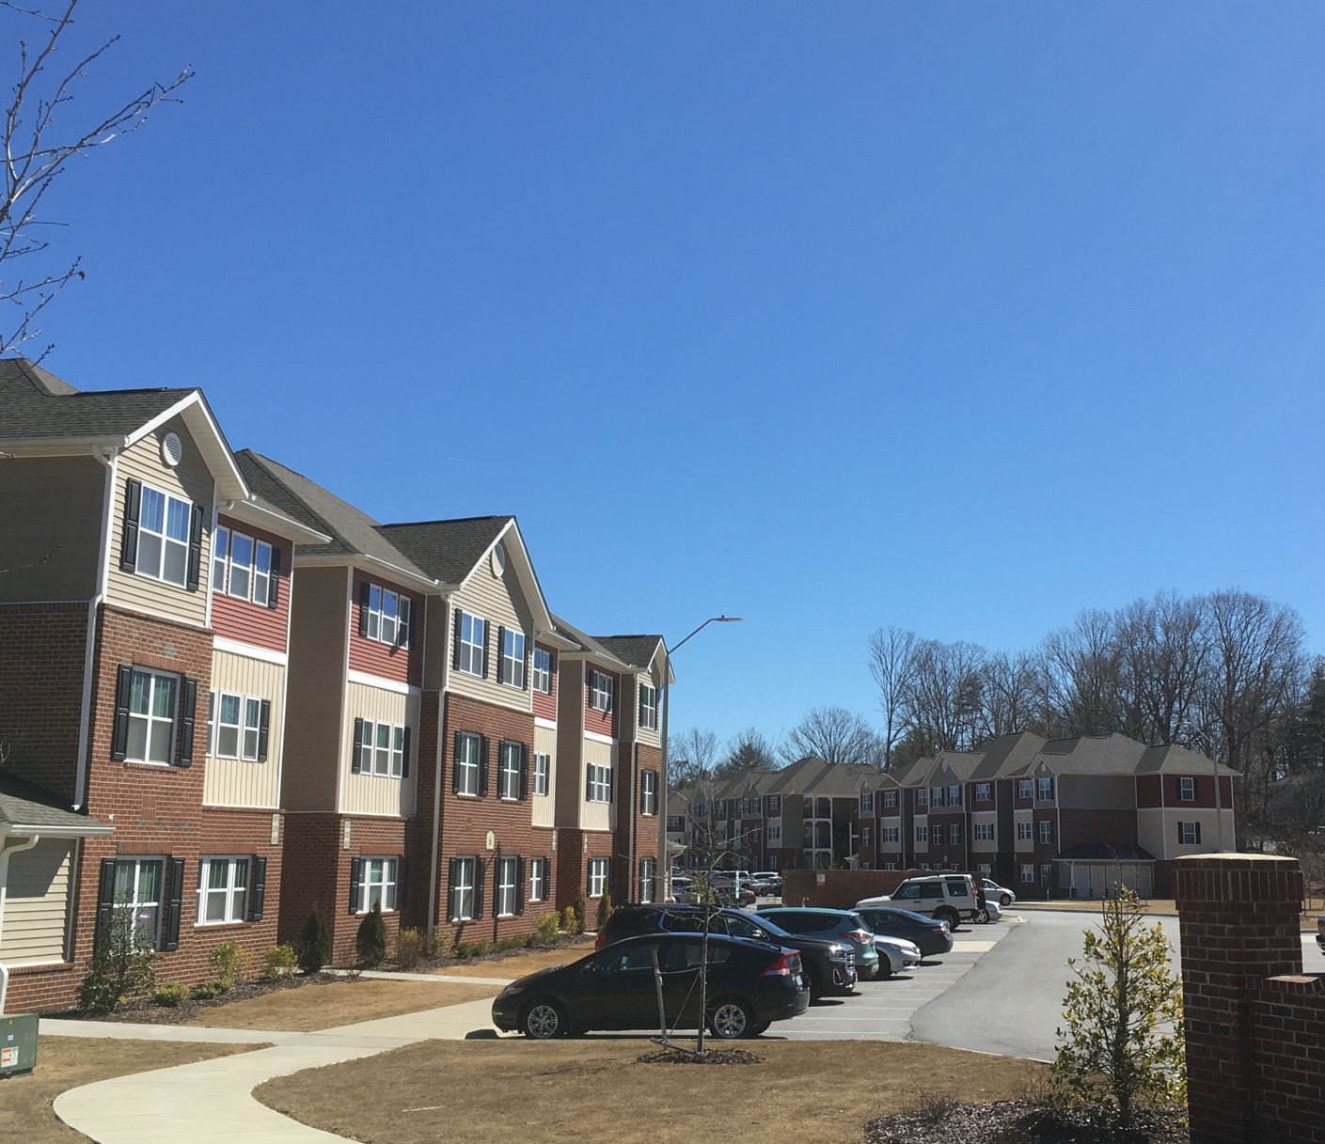
Maynard Crossing Apartments Maynard Lake Drive Erwin Board of Commissioners 2/6/25

Slide 2
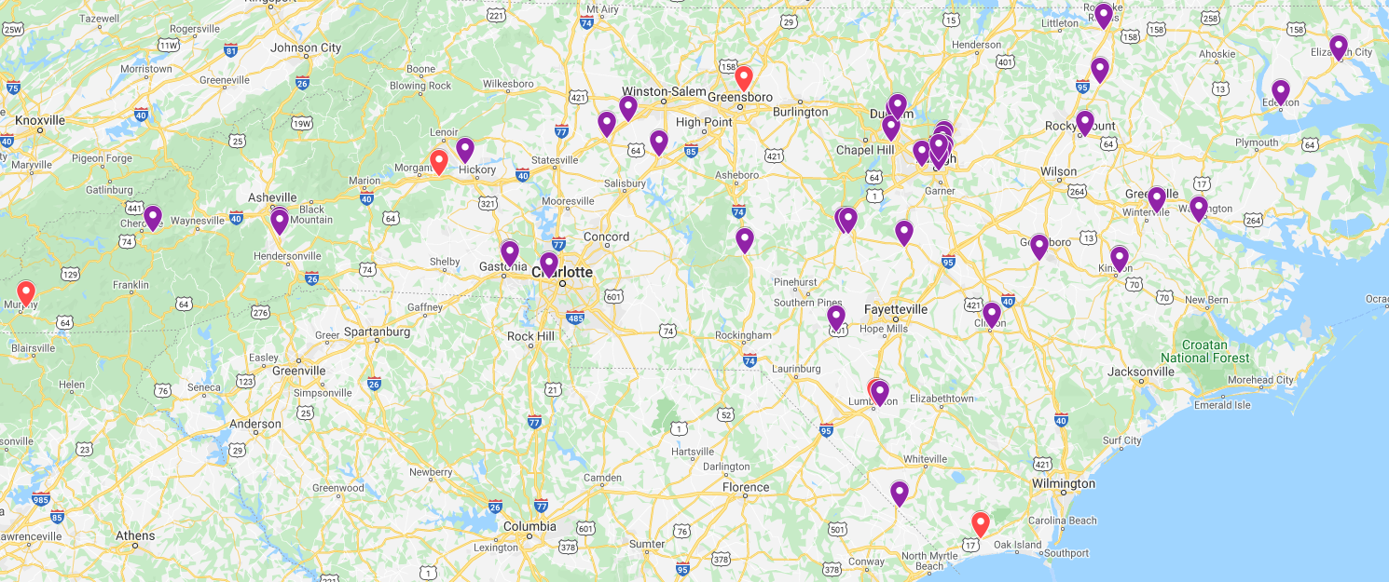
Experience – Over 50 Years of Quality Development
The Mills Family has been developing housing since 1968. Fred G Mills and Fred G Mills Jr., have been responsible for the creation of thousands of single and multi-family residences in the Southeast.
Over 3,500 units complete in NC across over 50 properties over the past 30 years
Development
Construction
Management

Slide 3
Overview
Seeking to modify the existing Special Use Permit to comply with new development plan and building design
Meets all Standards of the Zoning Ordinance and addresses all factors to consider when approving an SUP
Development has taken care to integrate seamlessly in the existing neighborhood with no negative impacts to surrounding neighbors, traffic or utilities capacity

Slide 4
Special Use Permit Standards
Compatibility with surrounding land use
Adequate facilities & infrastructure
Consistency with Land Development Plan
Use is desirable to the public welfare
Use will not impair the integrity of the surrounding districts
Adequate measures have been taken to provide ingress and egress to minimize traffic congestion

Slide 5
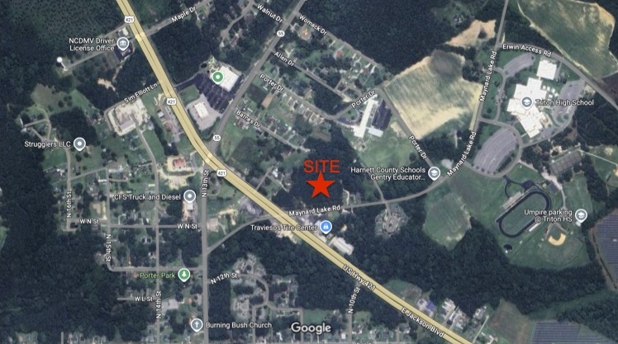
Site Overview
4.75 Acres
Current Zoning – Business District
Undeveloped
Access along Fairview Dr

Slide 6
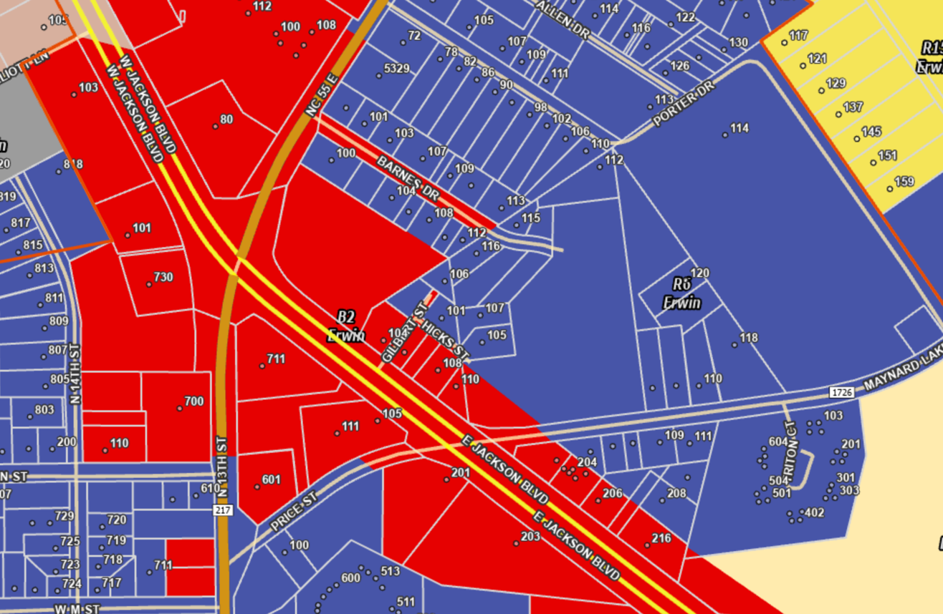
Zoning Overview
Current Zoning – R6 & B2 – the proposed development area is in the R-6 portion
Multifamily is a Special Use in R6

Slide 7
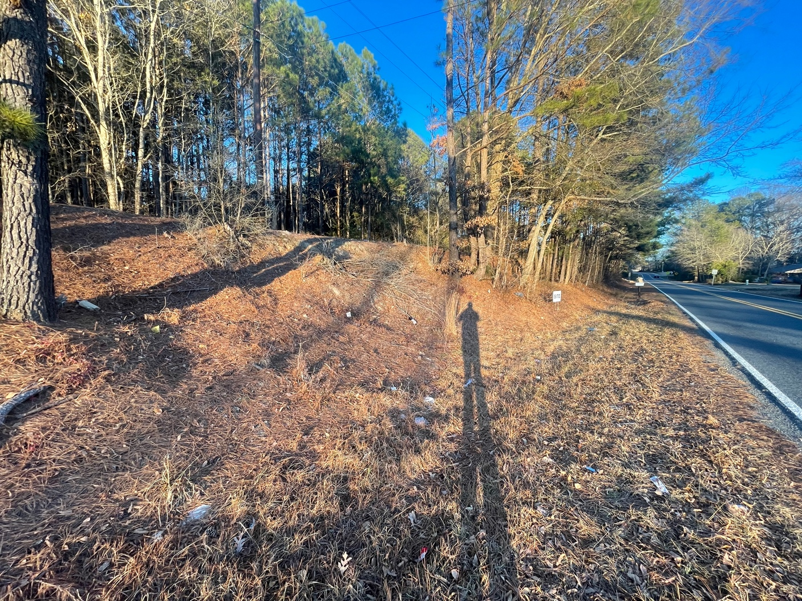
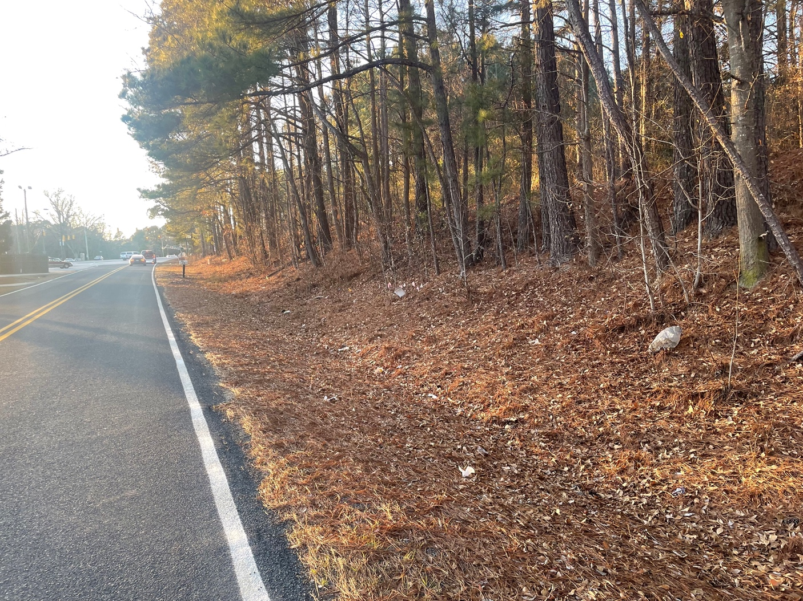
Site Overview

Slide 8
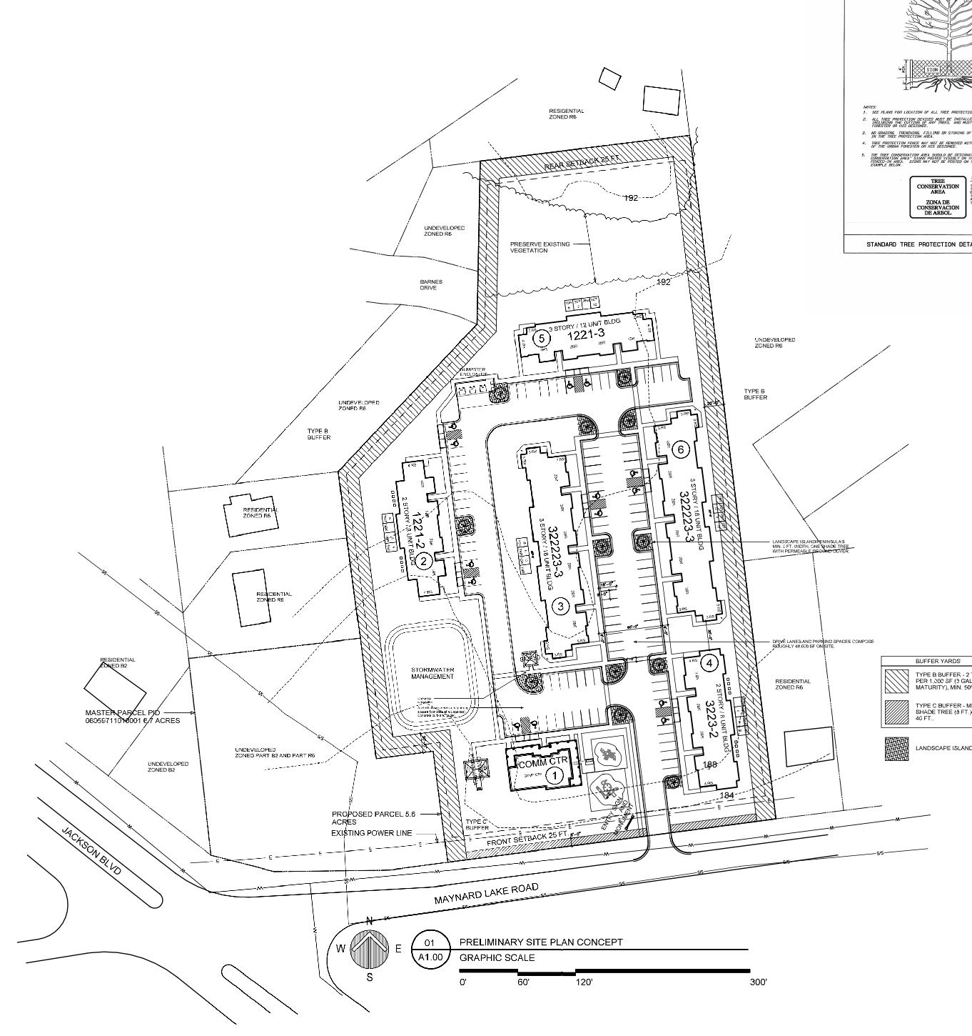
Development Plan
64-unit apartment development
Two 2-story residential buildings
Two 3-story residential buildings
10 – 1 Bedroom Units
38 – 2-Bedroom Units
16 - 3- Bedroom Units
Community Spaces
Computer Lab
Outdoor Picnic Area
Internal ADA compliant Sidewalks Room
Meeting Room
Playground & Tot Lot
Gazebo

Slide 9
Development Plan
20 Foot planted Type B buffer along sides and rear
Type C buffer along front
Additional building setbacks
Buildings have no open breezeways for quiet rear yards & minimal party walls
2-story buildings near neighboring single family development
Vegetation preservation along the back of the property abutting single family to the north
Shade trees throughout parking area & additional plantings throughout the property
Architectural features include gabled roofs, brick and vinyl siding, façade articulation through, and exterior storage
Variance Requests:
Reduced parking ratio to 1.5 spaces per unit
Additional 8” of building height on two buildings to achieve roof angles for architectural design and Energy Star efficiency

Slide 10
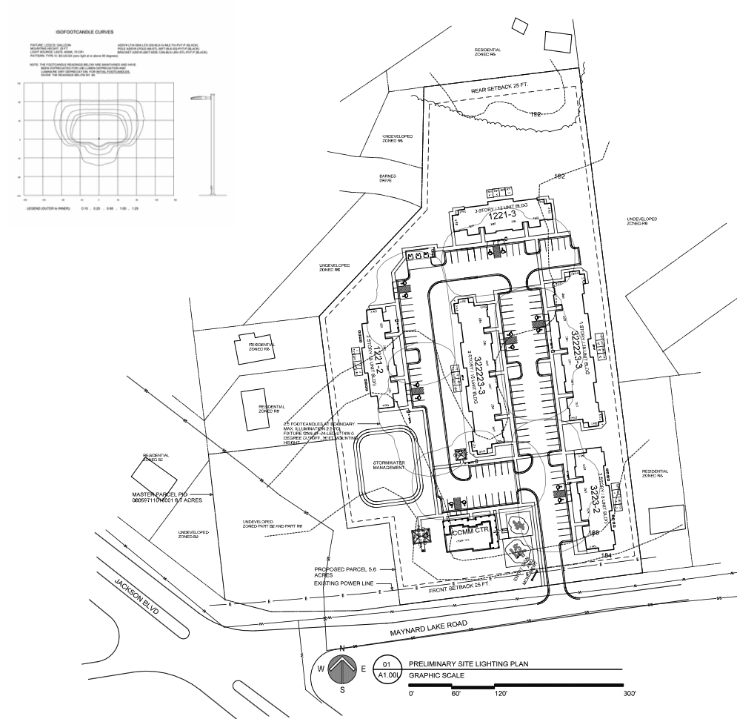
Lighting Plan
Plan shows visual impact showing how light is retained on site
Mounting height – 25 ft
Boundary shows 0.5 footcandles

Slide 12
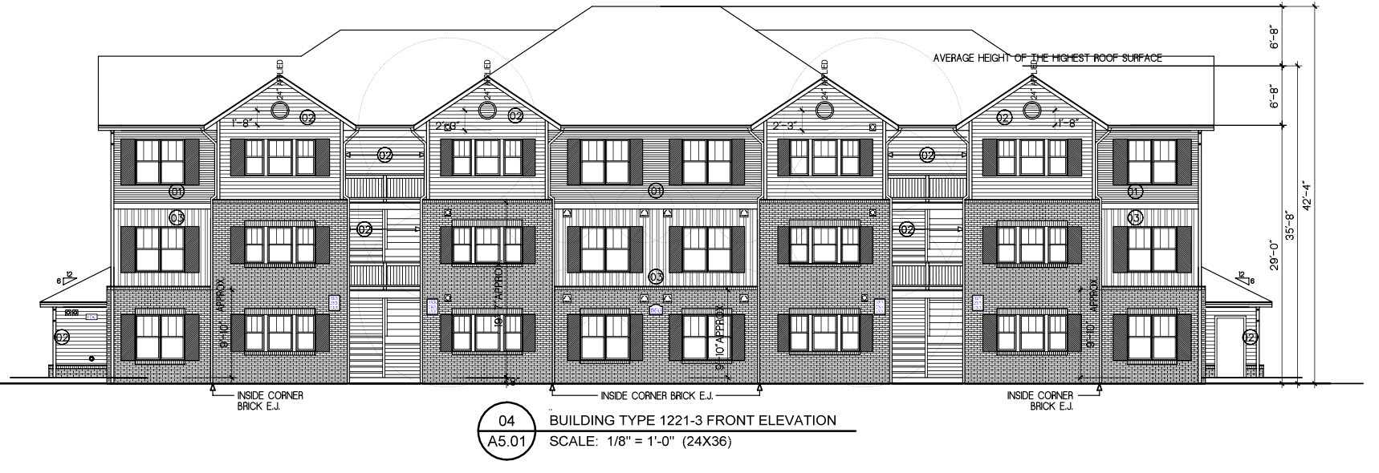

Slide 13
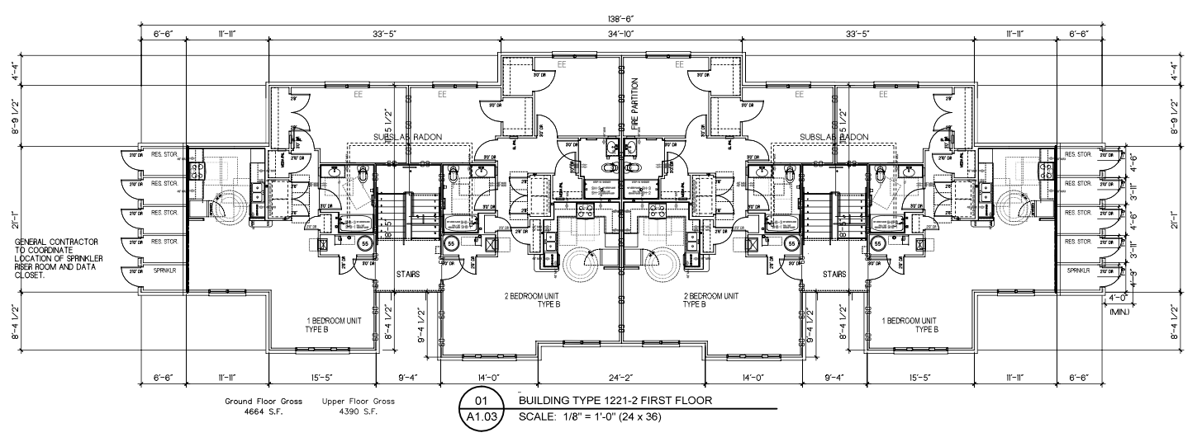

Slide 14
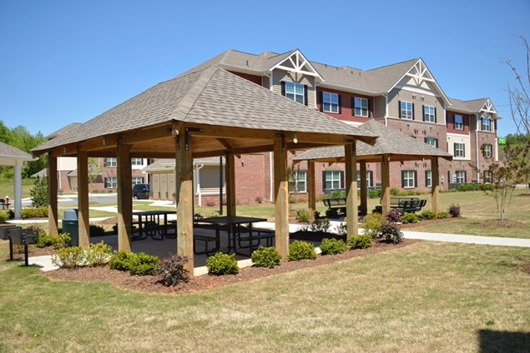
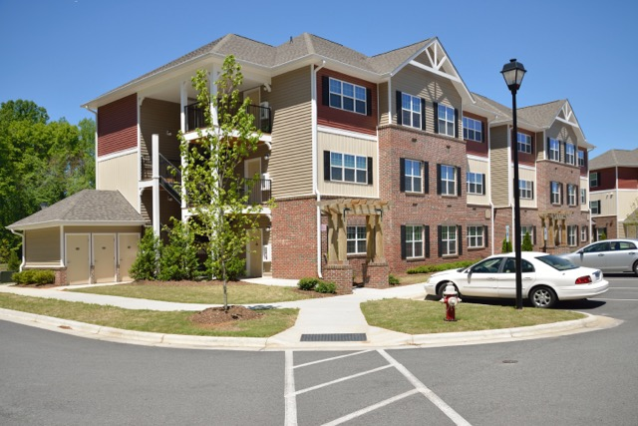
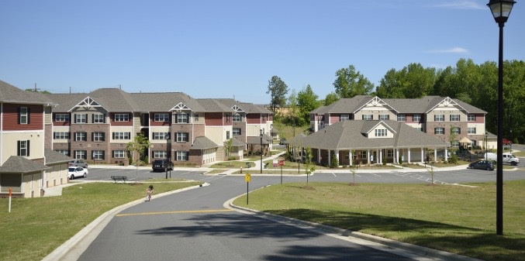
Building Design

Slide 15
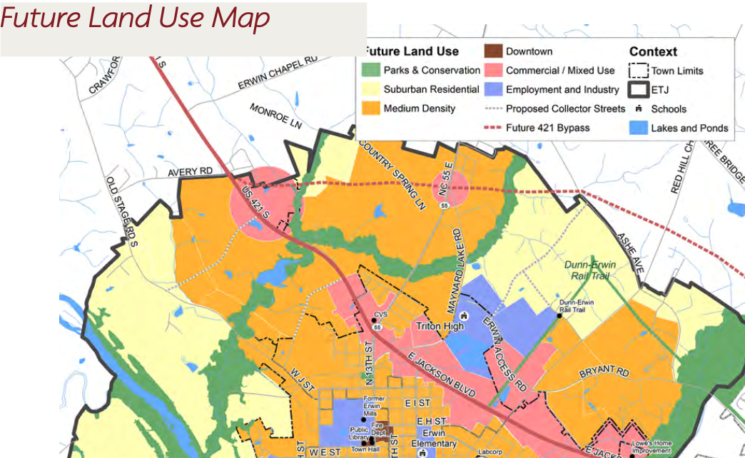
Erwin Land Use Plan
LUP designates property as Commercial/Mixed Use
Land Use and Housing Goal 4.1 “Encourage a mix of higher-density housing types to locate in Commercial/Mixed Use areas or near US-421”

Slide 16
Housing Need
Harnett County – 5,400 renters are cost burdened – spending more than 30% of household income on housing
2,500 renters spend more than 50% of household income on housing

Slide 17
Traffic Impact
Estimated Traffic Impact
DOT has reviewed for entrance plan and sees no issues with the concept as planned
Driveway permit will be applied for during civil engineering
64 units
245
245
11
33
31
18

Slide 18
Special Use Permit Standards
Multifamily Housing in this density is listed as a special use for this zoning district
Use is essential/desirable: New high-quality housing is needed in Harnett County
Use will not impair surrounding districts: Appropriate buffers are included, and care was taken to not impose on surrounding land uses
Use is in conformity with the land development plan: This site is located in an area marked as appropriate for high density development in close proximity to 421
Adequate utilities, road access, drainage, sanitation etc. are being provided: All are sufficient for a development of this scale

Slide 19
Thank you Bobby Funk bobby@millsconstructionco.com 828-551-6511

