Slide 1
Town of Erwin: Planning Board
PIN: 0598-92-2261.000
PID: 070598 0150
Current Zoning: RD (Rural District)
Proposed Zoning: B-2 (Highway Business)

Slide 2
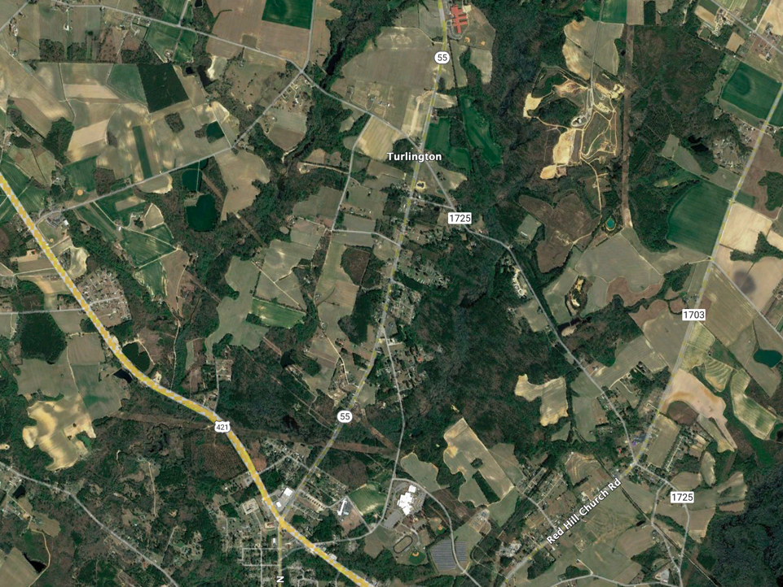
Trade Area Overview Aerial
Coats-Erwin Middle School
665 students/ 53 Teachers
Peak Horse Farm
Cape Fear Christian Academy
Judy’s Learning Center
Grade A Septic
Church
Site
Busy Bee Learning Center
Leap of Faith Academy
Division of Motor Vehicles
Triton High School
1,327 students /126 Teachers
Buffaloe Lanes Family Bowling Center
Oaksdale II Apartments
1.5-mile Radius

Slide 3
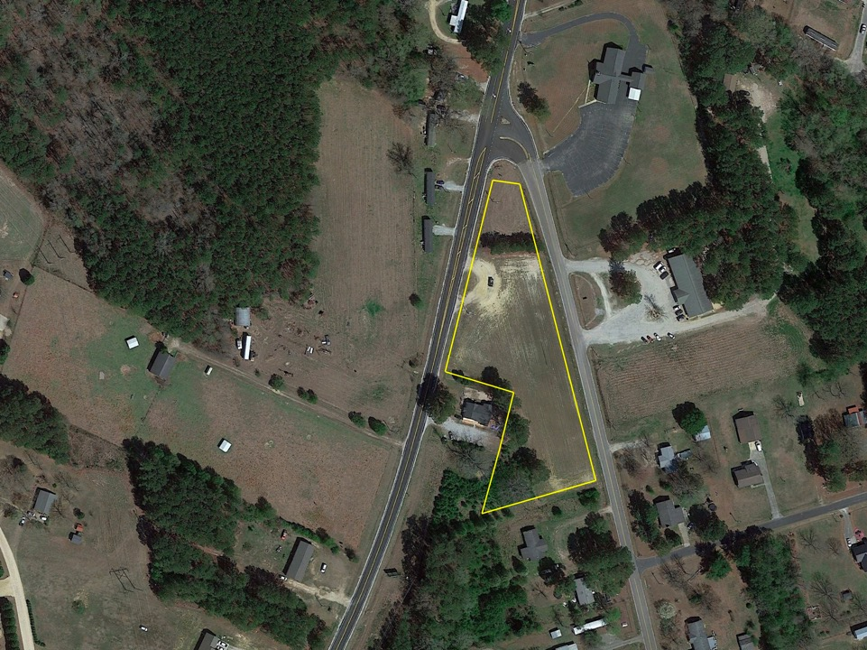
Site Aerial
The following are permitted uses and structures in Highway Business B-2:
Retail shops and stores and services establishments whose operation is conducted entirely within an enclosed building
Offices for business and professional purposes.
Trades and similar enterprises catering to household and business establishments.
Religious uses, including churches and other places to worship, religious education buildings, and parish houses.
Family care homes.
Municipal facilities
Mobile food vendors
Day care centers, day nurseries, preschools, and similar uses.
Leap of Faith Academy
Busy Bee Learning Center
Convenience store.
Midway Pentecostal Holiness Church
Site
HWY 55
Busy Bee Learning Center
Leap of Faith Academy
Maynard Lake Rd.
A zoning of B-2 would be consistent with current/existing the uses in the area.

Slide 4
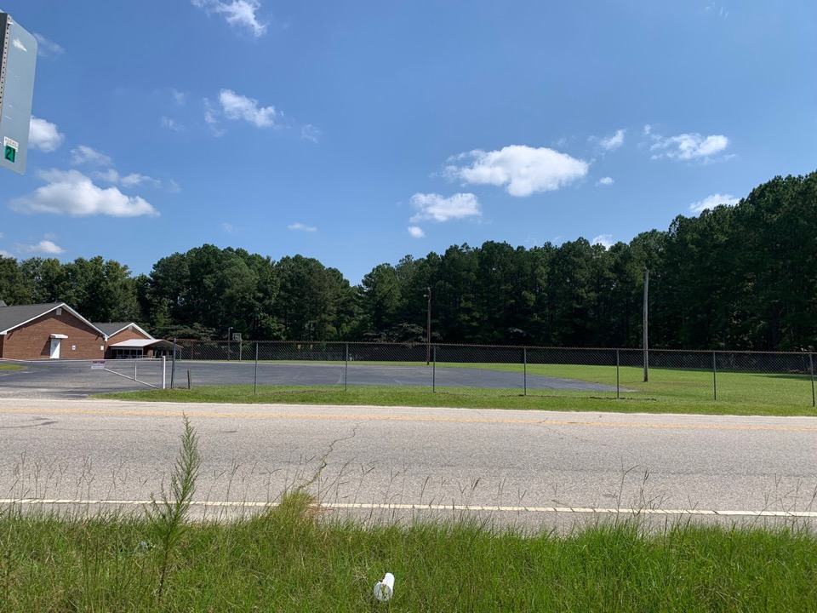
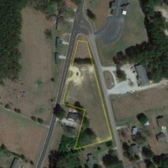
Across Site, Left
Midway Pentecostal Holiness Church
View Orientation
Maynard Lake Rd

Slide 5
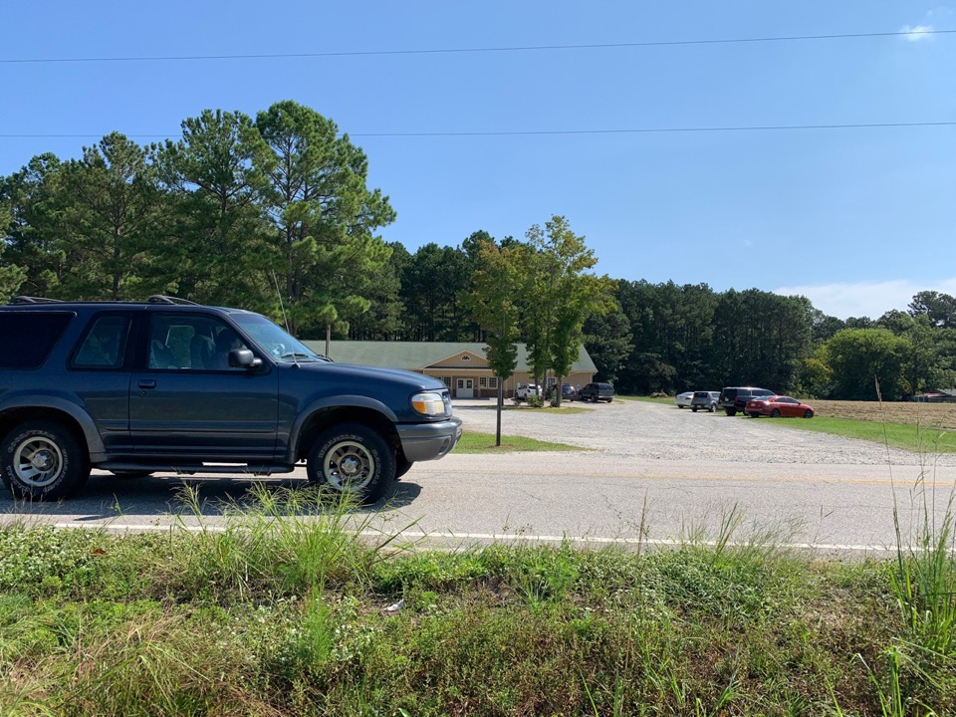
Across Site
Busy Bee Learning Center
Maynard Lake Rd
View Orientation

Slide 6
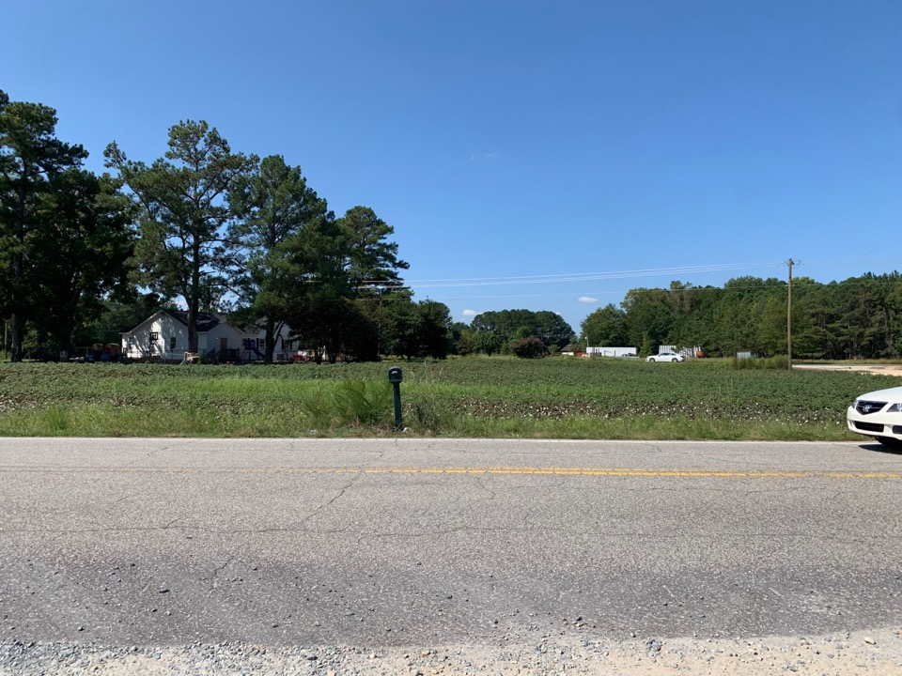
Site
Leap of Faith Academy
Site
Hwy 55
View Orientation
Maynard Lake Rd

Slide 7
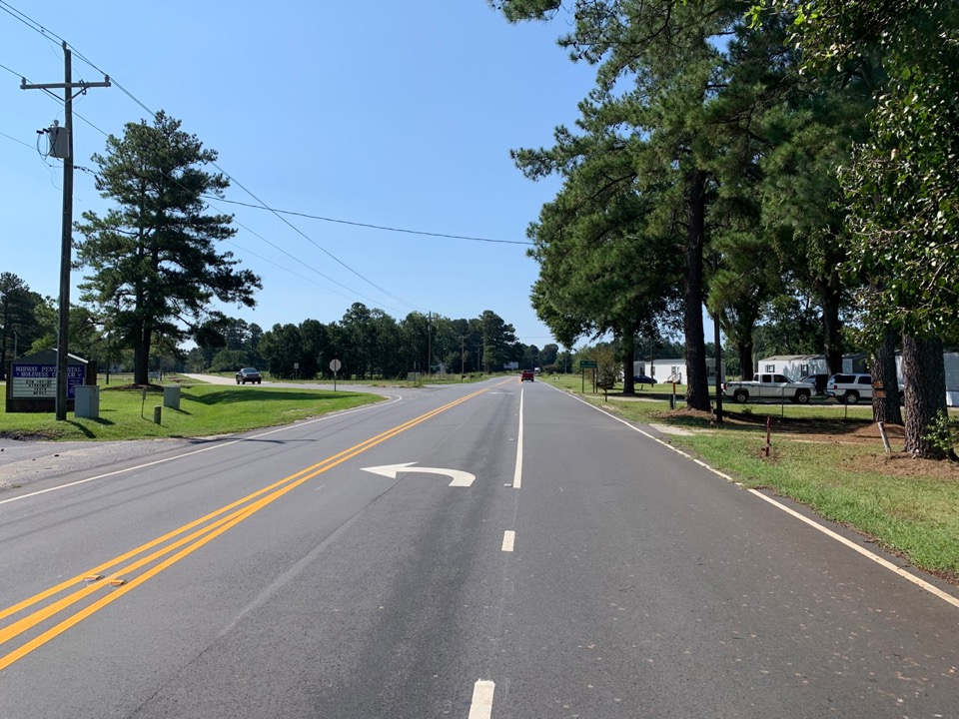
North on Hwy 55
Site
Hwy 55
View Orientation

Slide 8
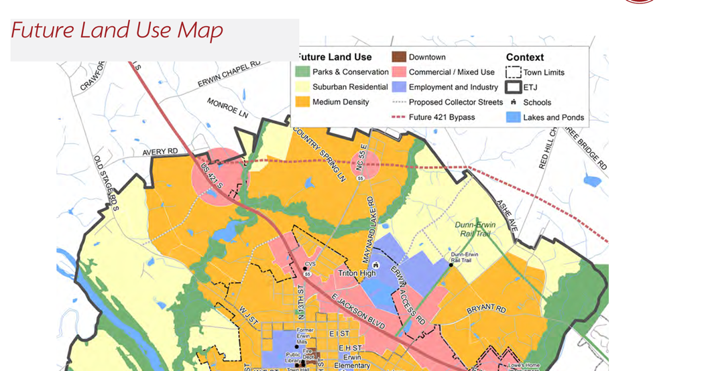
Town of Erwin Future Land Use Plan
Parcel Location
Proposed zoning of B-2 (Highway Business) on HWY 55 is compatible with the Town of Erwin’s Future Land Use Map for Commercial/Mixed Use

Slide 9
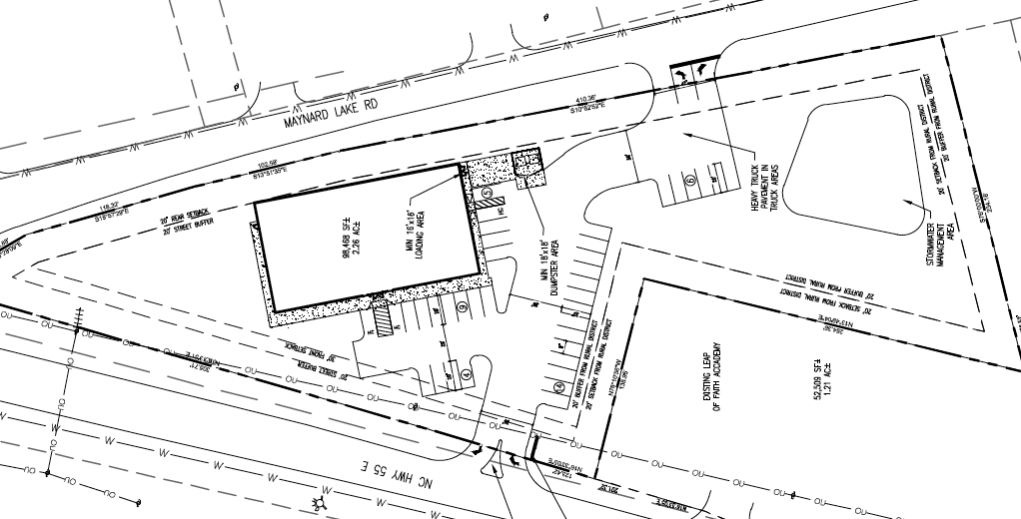
Updated Site Plan Design After Collaboration With NCDOT
Initial Site Plan Design

Slide 10
Traffic Counts Analysis
AM Peak Cars: 14 vehicles per hour
PM Peak Cars: 25 vehicles per hour

Slide 11
Permitting Process: Checks and Balances
North Carolina Department of Transportation (NCDOT)
Driveway Permit
North Carolina Department of Environmental Quality (NCDEQ)
Erosion and Sedimentation Control Permit
Stormwater Management Permit
Town of Erwin
Site Plan Approval
Zoning Permit
Harnett County
Building Permit

