Slide 1

Town of Erwin
Classification and Pay Study
2024-2025

Slide 2
The MAPS Group
Who We Are
  Founded in 1983
  8 consultants across the State
Partner with:
  Cities, Counties, Special Districts, Libraries, and others
Provide Public Sector Human Resource Services
  Classification & Pay Studies
  Personnel Policy development
  Supervisory Training/Staff Retreats/Team Building
  Performance Evaluation Design
  Assessment Centers/Selection Process
  Employee Engagement/Climate Surveys
  Personnel Officer Circuit Rider

Slide 3
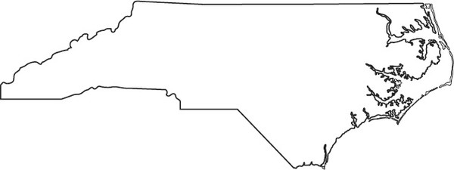
Clients Include
Municipalities
  Apex
  Boone
  Garner
  Fairmont
  Forest Town
  Garner
  Henderson
  Hendersonville
  Salisbury
  Whiteville
Counties
  Alleghany
  Beaufort
  Cherokee
  Harnett
  Mitchell
  Nash
  Orange
  Scotland
  Stanly
  Vance

Slide 4

Other Agencies
  NCLM
  Institute of Government
  Land of Sky Regional Board
  Central Carolina Board
Non-Profits
  North Wilkesboro Housing Authority
  Smithfield Housing Authority
  Dunn Housing Authority
  Laurinburg Housing Authority
  Tuckasegee Water & Sewer Authority
  Outer Banks Visitors Bureau

Slide 5
What is a Class and Pay Study?
Positions = Job Classifications and Compensation
Examine INTERNAL PAY EQUITY (pay relationships between positions) – ensure that positions with similar levels of complexity, responsibility, knowledge/skills required are classified comparably in the pay plan
Analyze external competitiveness (pay relationships with labor market competitors) (EXTERNAL PAY EQUITY)
Current pay practices
Update/draft personnel policy
Update and write new class specifications (job descriptions)

Slide 6

Primary Goals of the Study
Ensure market competitiveness of the Town’s pay plan with peer communities and the regional labor market
Ensure that the Town of Erwin can attract, retain, and motivate well-qualified, high-quality employees

Slide 7
Why Do A Classification Study?
  Several years since last study/pay plan review
  Jobs Change
    New Technology & New Services
    Reorganization / Shift in duties
  Market/Industry changes
  Enhance Recruitment Process
  Equitable Compensation System/Equal Pay for Equal Work
  Update the Town’s Compensation Philosophy
  Ensure Legal Compliance
    Fair Labor Standards Act, ADA, OSHA

Slide 8

Understanding the Study
Pay increases/reclassifications
are not guaranteed.
No pay decreases recommended.
Changes as a result of the study are subject to Management and Board approval
Study is not about…
How well people are doing in their work (job performance) How many people are required to do a particular job (staffing levels) Eliminating positions
Study is about the position (what the job does), not the person

Slide 9
Steps in Class\Pay Study
Identify Need
Employee Orientation
Questionnaires
Interviews
Salary Survey
Analysis/Position Review
Complete Analysis & Write Draft Report
Finalize Report
Write class specifications
Personnel Policy Update

Slide 10
Job Analysis – Classification Factors
Education, Training, and Certifications/Licenses
Experience Required for Position
Difficulty, Complexity and Variety of work
Problem Solving/Ingenuity
Independence of Action
Responsibility for Resources
Contacts with Others-Internal/External
Supervision Received and/or Given to Others
Consequences of Error/Job Decisions Required/ Risk Exposure
Working Conditions/Hazards/Environment
Physical/Mental Demands

Slide 11
These are not classification factors:
Volume of Work
Incumbent Length of Service
Employee Qualifications
Employee Work Performance

Slide 12
Job Analysis
External Equity
Internal Equity

Slide 13
Market Study ……
Comparable organizations
In the same market or similar market
Other organizations you recruit and hire from
Organizations offering similar services
Organizations you lose employees to
Typically within a commutable distance

Slide 14

Market Survey Organizations
Angier
Benson
Clinton
Dunn
Fuquay-Varina
Garner
Lillington
Nashville
Selma
Smithfield
Wendell
Zebulon
Harnett County

Slide 15
Sample Market/Salary Survey
Organization (Population) | Clerk Board |  | Finance Director |  | CSR Rep |  | Police Chief
 | Hiring | Maximum | Hiring | Maximum | Hiring | Maximum | Hiring | Maximum
Town of Conover | $58,597 | $84,965 | $74,786 | $108,440 | $31,200 | $40,870 | $86,574 | $125,532
8,428 |  |  |  |  | $35,973 | $52,161
Town of Granite Falls | $42,861 | $60,005 |  |  | $35,262 | $49,637 | $84,862 | $118,807
5,088
Town of Hudson | $54,550 | $81,825 | $69,621 | $104,432 | $33,489 | $50,233 | $69,621 | $104,432
3,801
Town of Lenoir | $51,218 | $71,705 | $96,185 | $134,659 | $31,350 | $43,890 | $96,185 | $134,659
18,500 |  |  |  |  | $32,937 | $48,446
Town of Newton | $58,311 | $87,497 | $82,083 | $123,124 | $30,926 | $46,839 | $90,482 | $135,724
13,175 |  |  |  |  | $35,805 | $53,708
Town of Statesville | $58,386 | $96,456 | $104,832 | $172,973 | $32,760 | $54,059 | $104,832 | $172,973
28,958
Town of Troutman | $48,450 | $76,308 | $87,227 | $137,383 | $39,462 | $62,153 | $96,168 | $151,464
4,144
Alexander County | $57,033 | $80,587 | $93,459 | $132,055 |  |  | $80,589 | $113,871
Wilkes County | $52,961 | $82,090 | $73,040 | $113,212 | $30,175 | $46,771 | $81,530 | $122,686
Average | $52,852 | $79,205 | $81,537 | $123,514 | $33,886 | $50,432 | $85,366 | $128,571
Recommended | $48,555 | $77,688 | $71,733 | $114,773 | $32,866 | $52,586 | $71,733 | $114,773
Grade | 62 |  | 70 |  | 54 |  | 70

Slide 16
Job Analysis
External Equity
Internal Equity
Job Value

Slide 17
Classifications by Grade
(sample pay plan)
Salary Grade | Class Title | Minimum | Midpoint | Maximum
16 | Park Technician Street Maintenance Worker | $32,819 | $41,024 | $49,229
17 | Equipment Operator WWTP Operator | $34,460 | $43,075 | $51,690
18 | Recreation Coordinator Maintenance Crew Leader Administrative Specialist | $36,183 | $45,229 | $54,275
19 | Police Officer Planner | $37,992 | $47,490 | $56,988
20 | Planner II Police Sergeant Customer Service Supervisor | $39,892 | $49,865 | $59,838

Slide 18
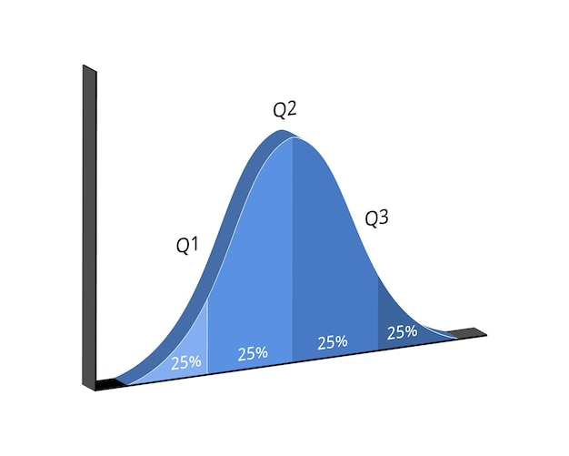
Salary Range Distribution

Slide 19
Project Overview
Pay Plan: The MAPS Group developed a pay plan that is tailored to the study results
Grade Assignments: Determined based on internal equity (job evaluation) and external market review
Implementation: With finalized grade assignments, we prepared implementation calculations for the updated pay plan to assist the Town in adopting the new classification and compensation system

Slide 20
Recommended Town Pay Plan
Salary Grade | Class Title | Minimum | Maximum
55 | Public Works Technician | $34,509 | $55,214
56 | Senior Public Works Technician | $36,234 | $57,974
57 | Heavy Equipment Operator | $38,045 | $60,872
58 | Park Maintenance Supervisor | $39,947 | $63,915
59 | Police Records Specialist/Evidence Tech Fiscal Specialist | $41,944 | $67,110
60 | Code Enforcement Officer | $44,041 | $70,466
61 |  | $46,243 | $73,989
62 | Athletic Program Manager Police Officer School Resource Officer | $48,555 | $77,688

Slide 21
SG | Class Title | Minimum | Maximum
63 | Planner Police Corporal | $50,982 | $81,571
64 | Police Investigator | $53,531 | $85,650
65 | Police Sergeant | $56,207 | $89,931
66 | Master Sergeant | $59,017 | $94,427
67 |  | $61,967 | $99,147
68 | Police Lieutenant | $65,065 | $104,104
69 | Town Clerk/HR Director | $68,318 | $109,309
70 | Public Works Director Parks and Recreation Director | $71,733 | $114,773
71 | Finance Director | $75,319 | $120,510
72 |  | $79,084 | $126,534
73 | Police Chief | $83,038 | $132,861
74 |  | $87,189 | $139,502

Slide 22
Implementation Options
Option 1
Employees are moved into the range above the Minimum rate based on .5% per year of service with the Town.
Annual cost to implement Option I (.5% per YOS) = $67,168 (4.7% payroll)
Option 2
Employees are moved into the range above the Minimum rate based on 1% per year of service with the Town.
Annual cost to implement Option 2 (1% per YOS) = $114,669 ($7.8% payroll)
Option 3
Employees are moved into the range above the Minimum rate based on 1% per blended years of service with the Town and years in current position.
Annual cost to implement Option 3 (1% per blended YOS) = $100,503 (6.9% payroll)

Slide 23
Compensation Structure
Labor Market
Internal Equity
Salary Structure
Benefits
Pay Movement

Slide 24
Next Steps
Class specifications will be written for all Town positions
The personnel policy review will be completed with recommendations for updates
A final report will document the methodology used to conduct the study, our findings, and recommendations

Slide 25
Final Goal
The goal is to ensure that the classification structure and the compensation program are:
  Accurate
  Equitable
  Market Competitive
  In order to attract and retain a highly qualified workforce

Slide 26
Recommendations
We urge the Town of Erwin to:
Adopt the recommended class and pay plan with grade assignments
Continue efforts to maintain the classification and compensation system:
  Routinely review positions, job descriptions, and market conditions
  Adjust the pay plan and salaries, annually, to keep pace with the market
  Adopt general or market increases, annually, to reward employees and ensure advancement through the assigned pay ranges

Slide 27

Questions

